Slide 1
IceCube Management and Operations
K. Hanson | 2020.09.29 – 09.30
International Oversight and Finance Group
Virtual Meeting

Slide 2
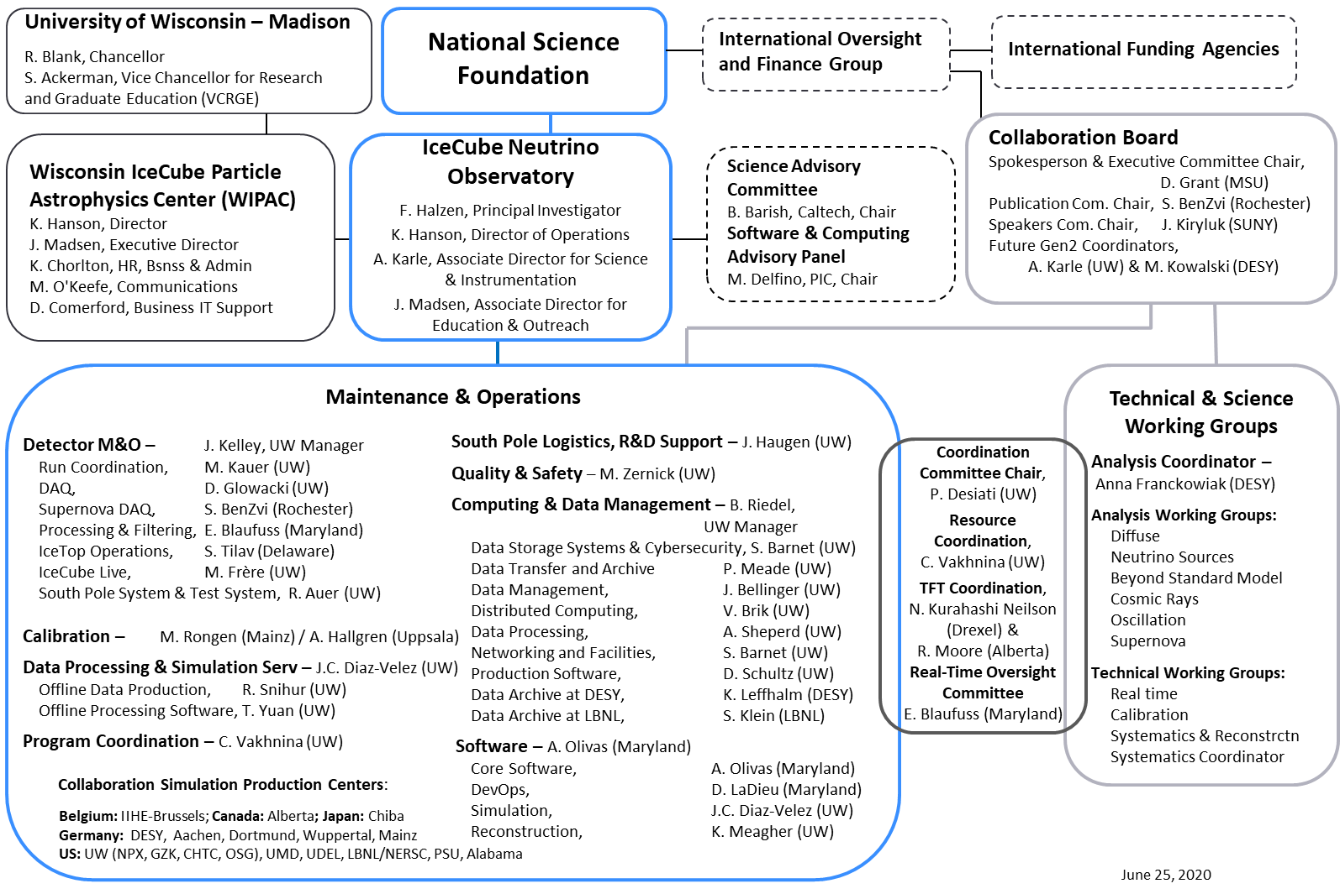
ICNO Org Chart
Effectiveness of ICC increased by appointment of WG technical leads 2018+ that represent WGs in monthly coordination meetings
Notes:
M&O provides infrastructure support :
maintain / operate the detector.
provide computing infrastructure – compute and storage + data processing + software + calibrations
coordinates labor / cash / computing resources within collaboration – ICC + WG technical leads as link to collaboration science requirements
as drg pointed out new web-based resources coordination / tracking replace manual system

Slide 3
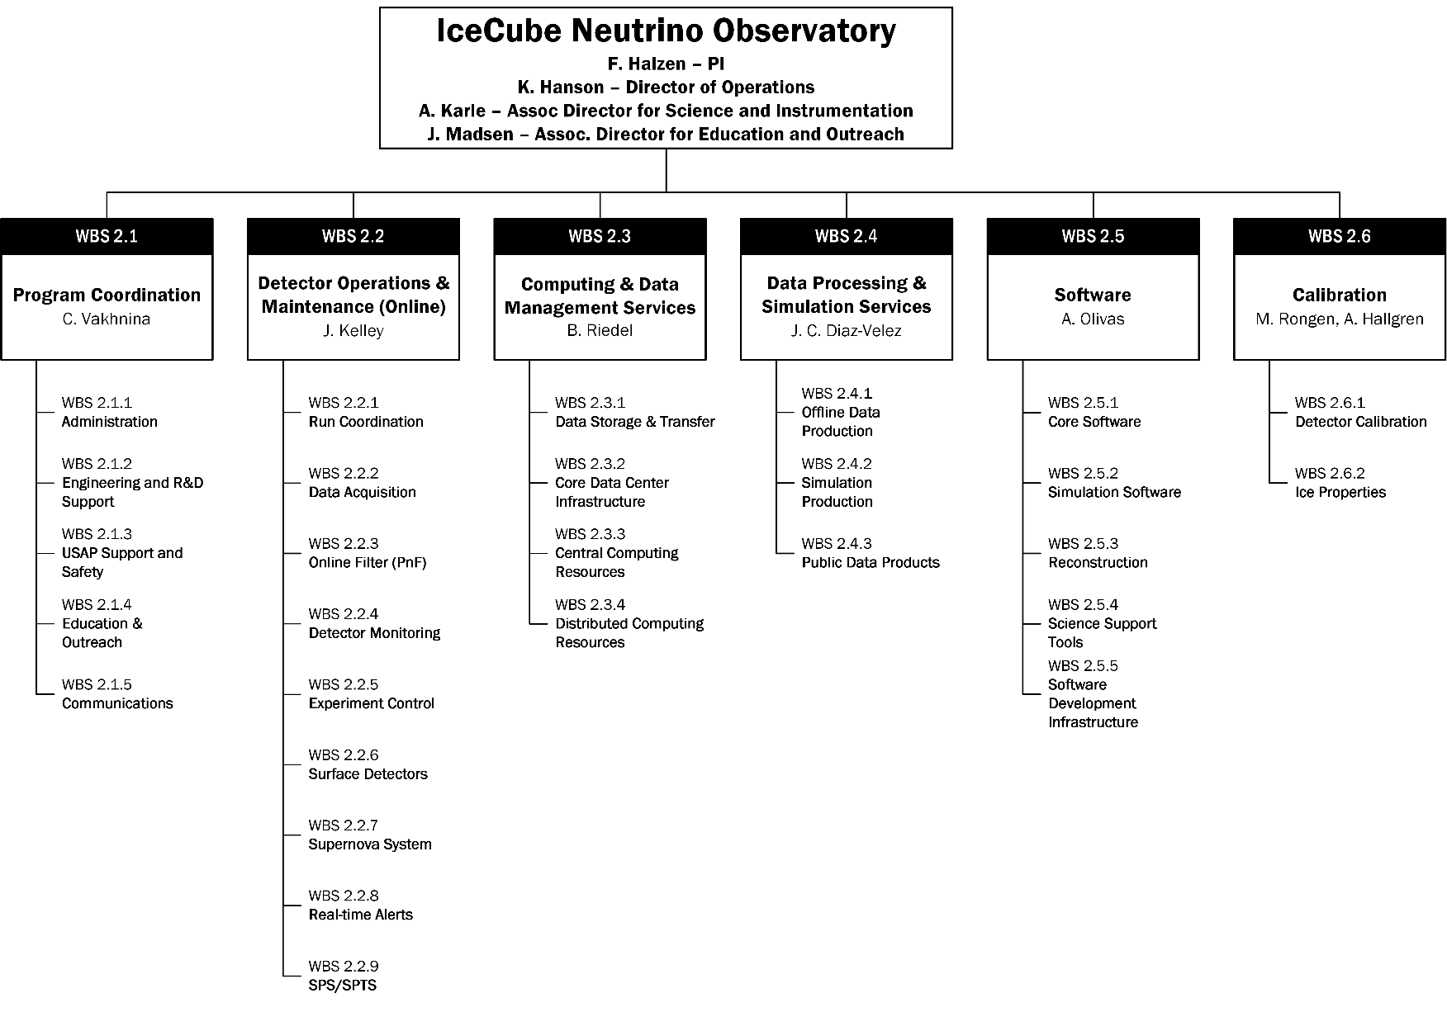
Minor Changes to ICNO WBS
Consolidated and moved to 2.2
More centralized
More distributed
Notes:
Deliverables for M&O shown here
more WIPAC / centralized on the left
more collaboration / distributed on the right
major refactor 5 years ago to align with ICC
few changes since

Slide 4
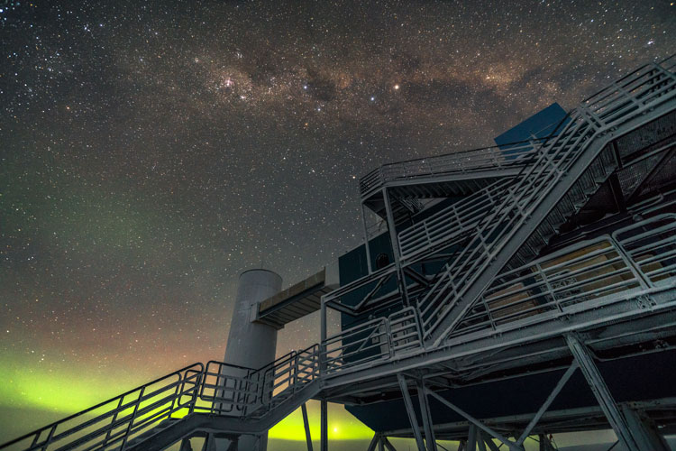
Technical Performance

Slide 5
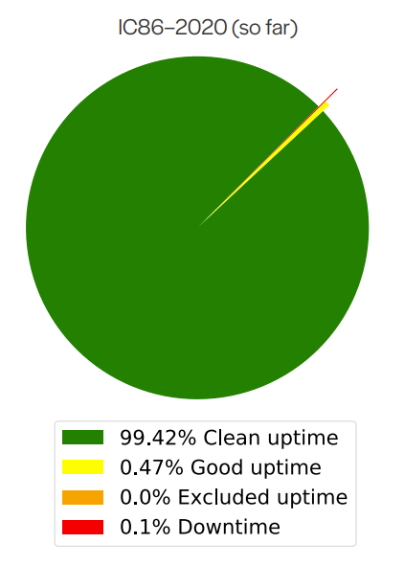
Detector Uptime
Detector uptime 99.4% since beginning of IC86-2020 (97.4% since beginning of M&O PY5).
98.5% of deployed DOMs active, producing data. MOST OF THESE FAILURES AT DEPLOYMENT.
  Zero channel failures since Dec 2018.
  3 DOM failures within last 5 years.
Feature additions DAQ to improve robustness (hitspooling updates) and calibration measurements (low-deadtime readout mode)
No changes on online filter for IC86-2020 physics runs.
Notes:
Detector must be recording for rare astrophysical events – uptime is key
IceCube detector stability / data quality is unprecedented : detector unavailable for less than 0.1% of wall time since May 2020 and fraction of data NOT USED by all analyses < 0.5% (could go back and use that data but would increase systematics)
Hard to improve on this! But ... DAQ hitspooling (ALL hits collected / stored for O(1 week)) may effectively make this 0%

Slide 6
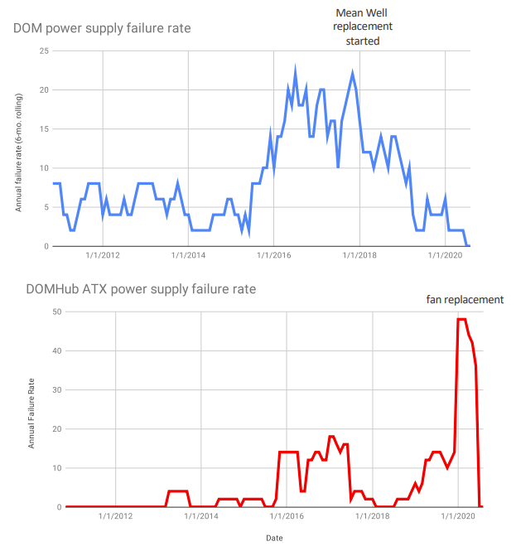
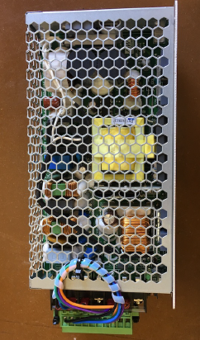
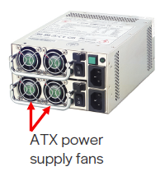
Lest it Look Easy
This is not to say that there could not have been problems. Active monitoring by the detector operations team caught two potential issues before they became critical:
DOM 48V power supplies began to exhibit aging late 2015. Ops team identified, replaced with cheaper, more power efficient alternative power supplies. No failures since completing overhaul.
WOs noted problem late 2018 in the ATX (computer industry standard) power supplies. Redundant PS so no impact to online but tracked to cooling fans. 19/20 season all fans replaced – no failures since replacement.
Mean Well MSP-200-48. Almost COTS with custom pigtail to mate with DOM power connectors.
ATX redundant power supply with fan units indicated.
Notes:
Power supplies are typically the failure points in electronics
Detector systems extensively monitored – catches problems at early stage

Slide 7
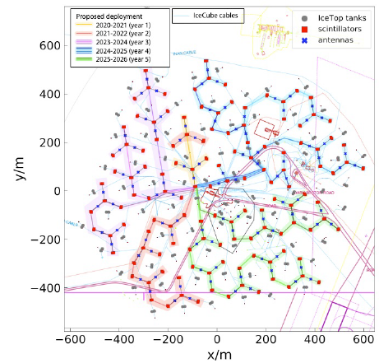
2020/2021 Season Plans
As of early summer 2020, NSF/USAP field activity in Antarctica limited to activities to (1) support basic operation of US scientific stations, or (2) prevent degradation of scientific installations.
Operation of IceCube falls within scope of (2): ICNO field activities scaled back to minimal operations to keep detector running. New WO crew, M. Wolf, returning WO (Munich, DE) + J. Veitch-Michaelis, new WO (London, UK) will replace existing crew.
Previous to COVID-19 M&O planning for 2020/2021 was forecasting an exceptionally light season:
Major ICL server upgrades (last upgrade 2014) were completed in the 2018/2019 and 2019/2020 seasons.
Critical DOMHub maintenance (DOM PS / ATX PS fan replacements) also completed 2019/2020.
Fieldwork associated with surface scintillator (full scope still under review) to restore loss of sensitivity due to snow accumulation DELAYED.
Notes:
Will discuss further in COVID-19 impact section

Slide 8
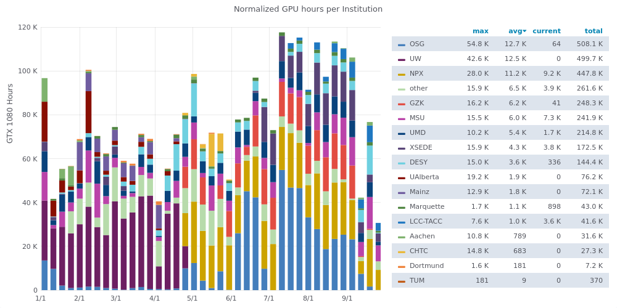
Computing Resources - GPU
Units: (Normalized) GPU hours per week
Note: Supercomputer clusters
Notes:
GPU – massively parallel architecture (gaming graphics cards) used for photon propagation
Still specialized hardware – Amazon spot pricing is higher than in-house GPU solutions
Collaboration is gaining GPU resources at institutions
Improvements in distributed middleware give access to XSEDE (virtual distributed supercomputing resources) + TACC (Texas)
Looking for other massive computing resources, esp. in EU exist opportunities to use yesterday’s SC clusters.

Slide 9
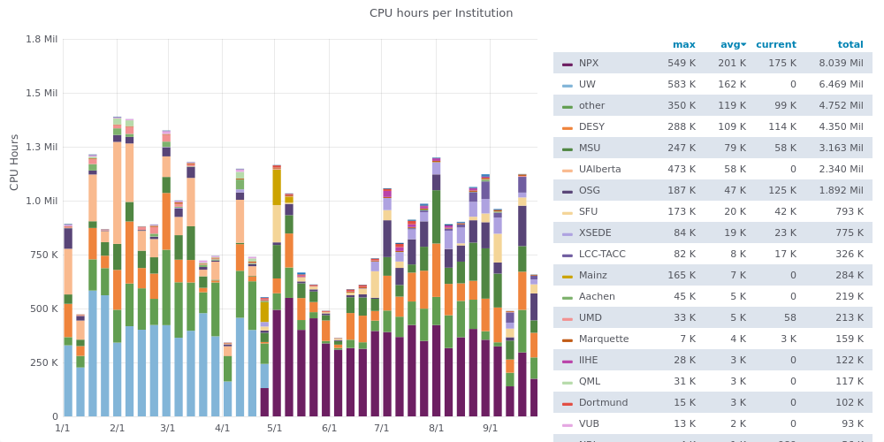
Computing Resources - CPU
Units: CPU hours per week
Notes:
Same for CPU
Units CPU hr / week (divide by ~150 to get physical cores)

Slide 10
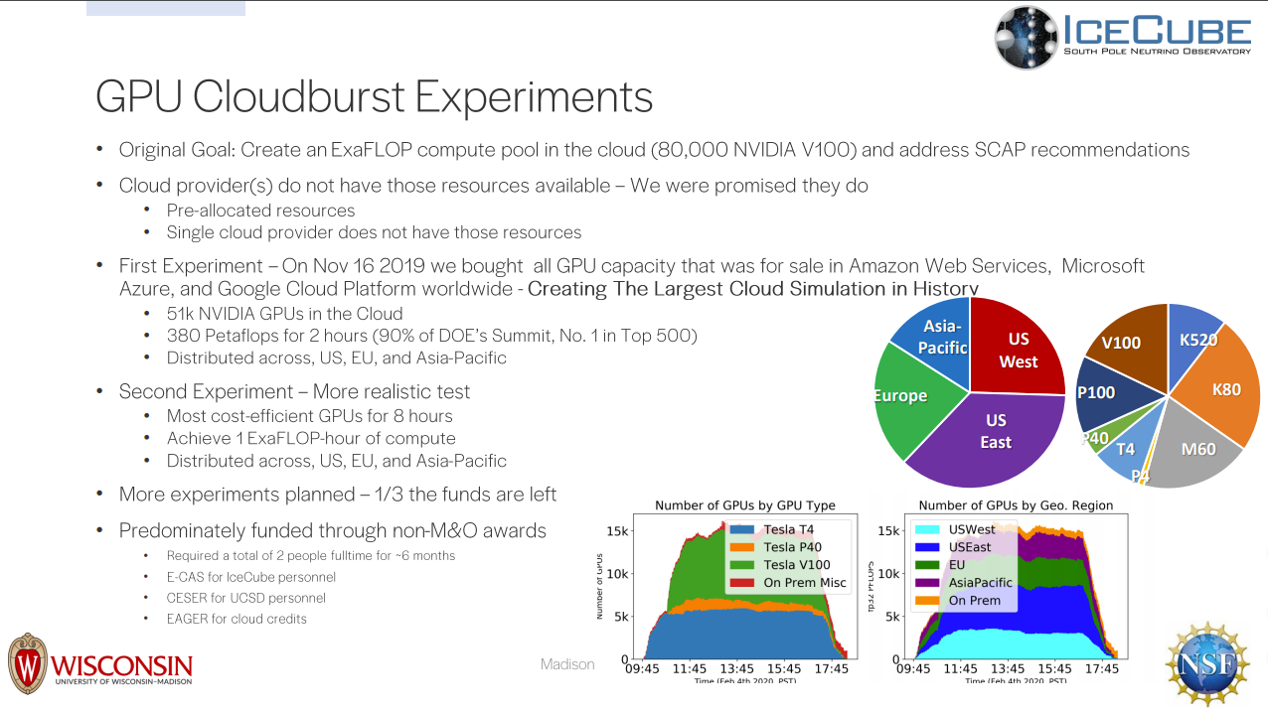
Scaling IceCube Computing to Terascale
Notes:
Our previous computing advisory panel recommended 10x scaling to test IceCube middleware
Cloudburst created largest transient (non-defense!) computing simulation in HISTORY!
100x scaling of scheduler

Slide 11
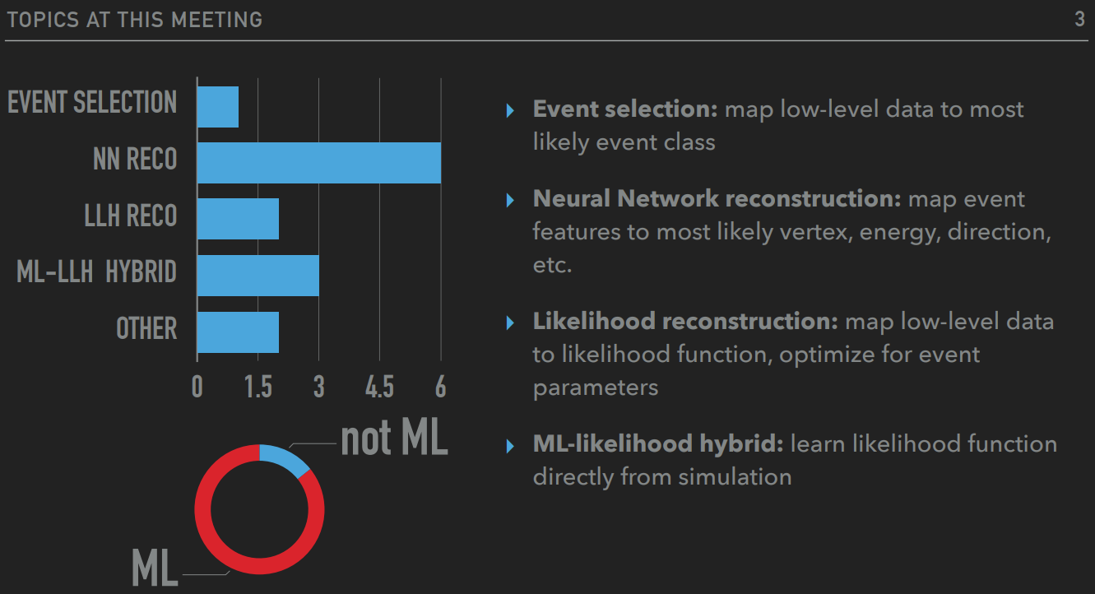
IceCube and AI
Takeaway message: ML/AI here to stay, revolutionary improvements to IceCube event reconstruction. These applications nevertheless make new demands on computing: high-memory, GPU/TPU architectures. M&O is committed to finding new avenues to support these initiatives.
Notes:
As mention in FH talk ... AI, in particular deep learning, is becoming a backbone of IceCube data analysis

Slide 12
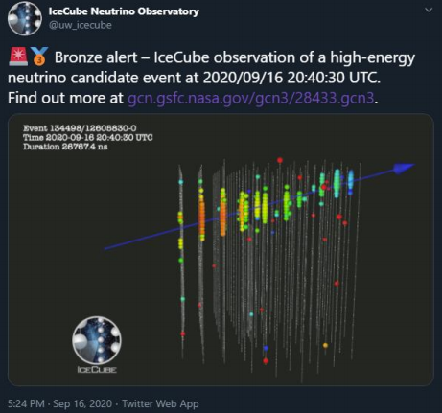
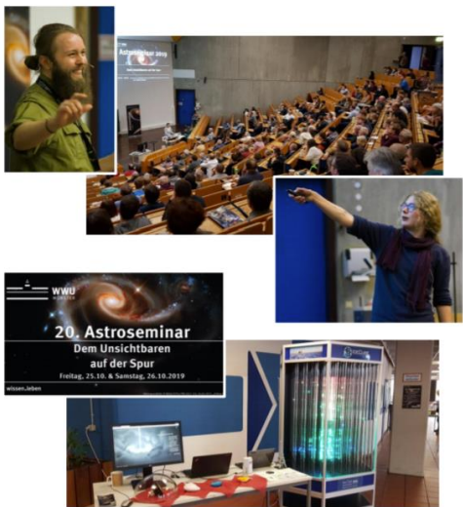
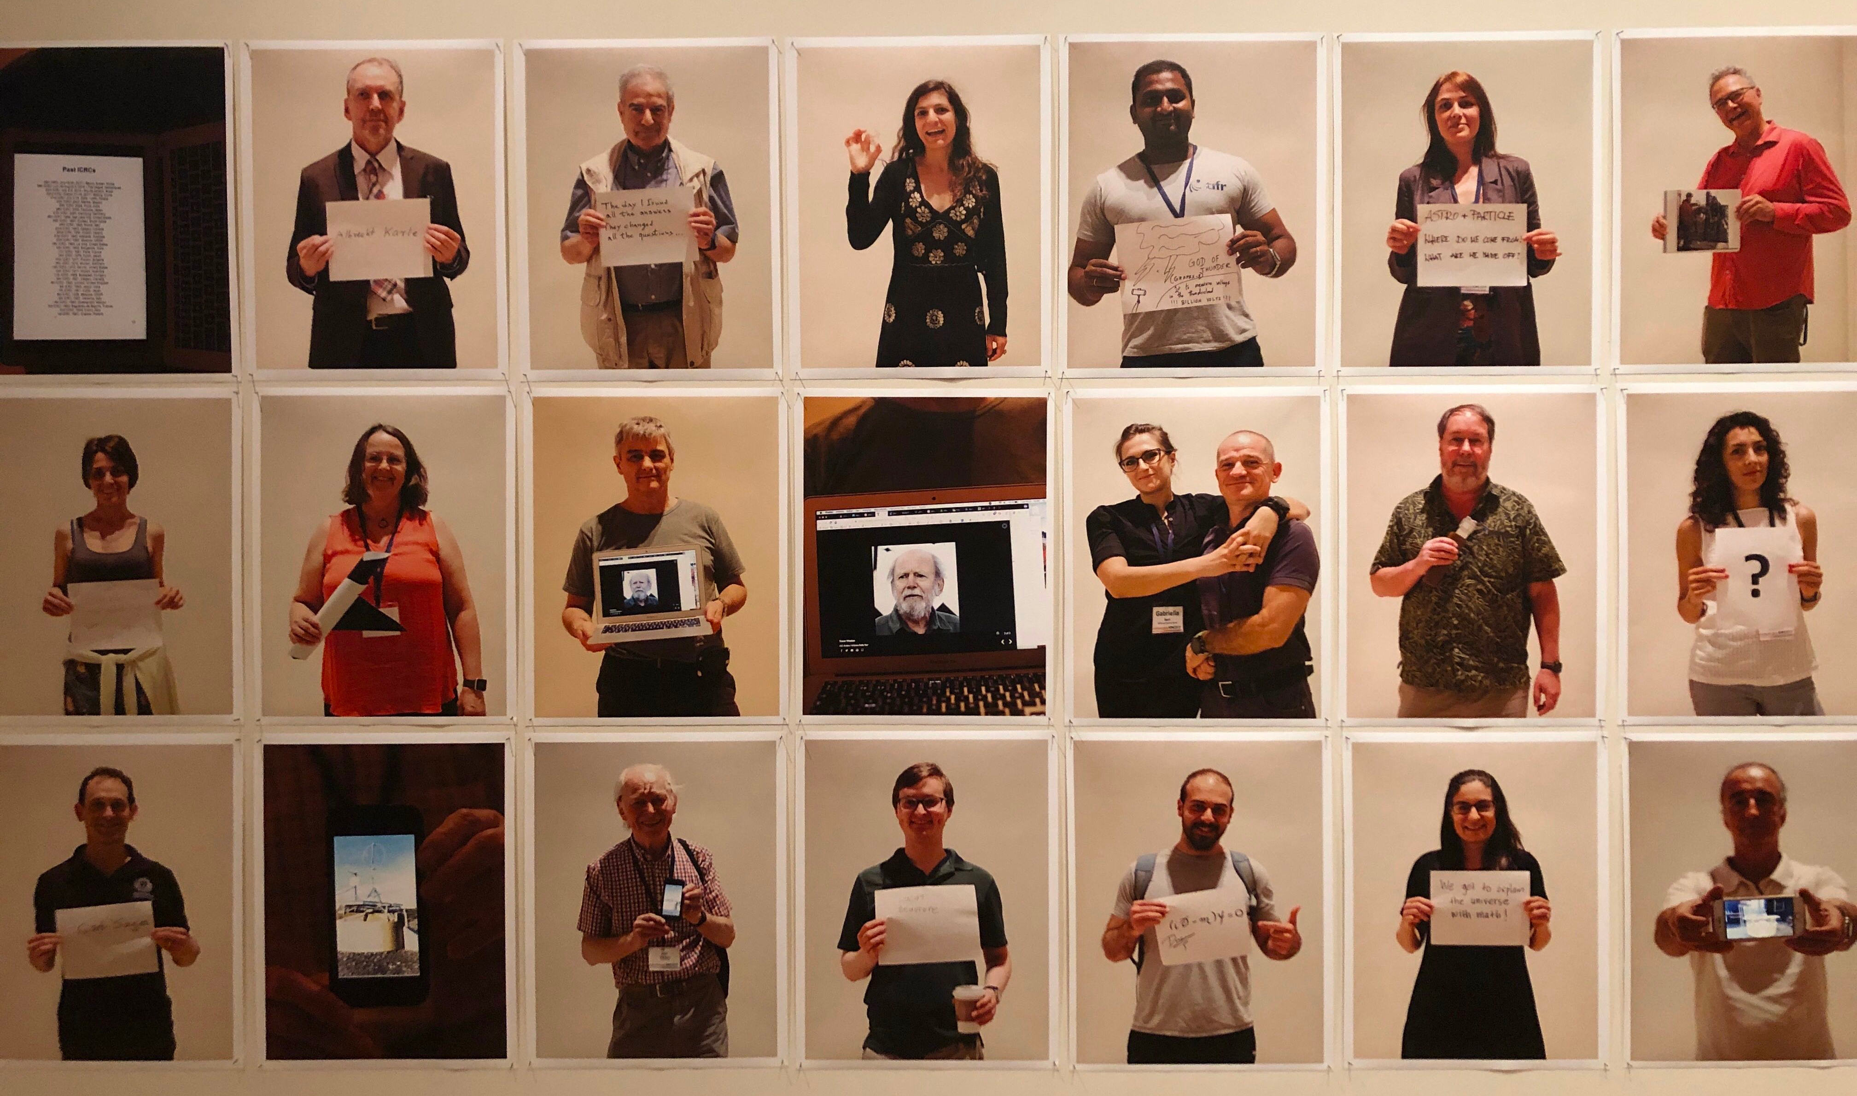
Education Outreach and Communications
Notes:
Too many activities in E&O + Communications + DEI
Rosie and Gibbs – children’s comic strip
IceCube Master Classes modeled after CERN for past 7 years – very popular
High school internships
Finally something useful on Twitter – GCN alerts!

Slide 13
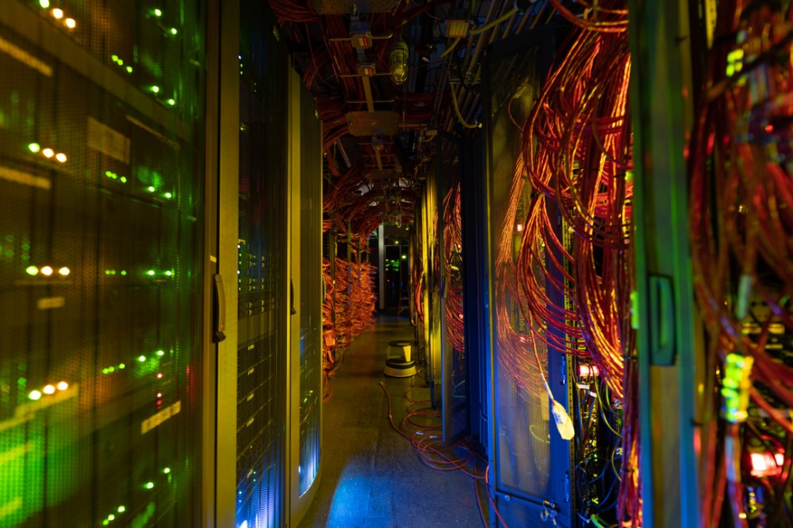
Financial Performance

Slide 14
IceCube NSF M&O Award Budget, Actual Cost and Forecast
(a) | (b) | (c) | (d)= a - b - c | (e) | (f) = d – e
YEARS 1-5 Budget (Apr.’16-Mar.’21) | Actual Cost To Date through 08/31/2020 | Open Commitments 08/31/2020 | Current Balance 08/31/2020 | YEAR5 Remaining Projected Expenses Sep‘20-Mar‘21 | End of YEAR5 Forecast Balance 03/31/2021
$35,360K | $30,862K | $621K | $3,877K | $3,853K | $24K
This five-year NSF M&O renewal program started in April 2016 and is ending in March 2021.
NSF award of $7M per year: $35M total
NSF Supplemental funding of $292K to develop a multimessenger INCLUDES program and $68K for SDSM&T
Total actual cost as of August 31, 2020 is $30,862K and open commitments are $621K. The current balance as of August 31, 2020 is $3,877K. With a projection of $3,853K for the remaining expenses during the final seven months of PY5, the estimated unspent funds at the end of PY5 are $24K (0.07% of the total PY1-PY5 budget).
Previously projected negative balance was reduced with the start of the NSF IceCube Upgrade award and turned positive with the lack of travel expenses in PY5 due to the COVID-19 pandemic.

Slide 15
IceCube M&O Computing Infrastructure Common Fund Expenditures
System Upgrade | Computing Infrastructure | Detector Infrastructure | Labor | Total
South Pole System | $311K | $81K | $574K | $966K
South Pole Test System | $256K | $12K |  | $268K
Data Warehouse | $662K |  |  | $662K
UW Data Center | $318K |  |  | $318K
TOTAL | $1,547K | $93K | $574K | $2,214K
2018/19
System Upgrade | Computing Infrastructure | Detector Infrastructure | Labor | Total
South Pole System | $7K | $170K | $512K | $689K
South Pole Test System |  | $4K |  | $4K
Data Warehouse | $8K |  |  | $8K
UW Data Center |  | $284K |  | $284K
TOTAL | $15K | $458K | $512K | $984K
2019/20
IceCube Common Fund established to enable collaborating institutions to contribute to cost of maintaining South Pole detector systems, central computing resources for entire collaboration.
This summary includes the operational support expenses over the 2018/2019 (top) and 2019/2020 project fiscal years for: South Pole System (SPS), South Pole Test System (SPTS), UW Data Center, UW Data Warehouse and networking equipment that are funded by IceCube M&O Common Fund.
Detailed expenditures information by cost category, vendor, quantity and line item description can be found in the annual Common Fund Status reports on Docushare:
https://docushare.icecube.wisc.edu/dsweb/View/Collection-8986

Slide 16
COVID-19 Impact on M&O

Slide 17


Operational Impact Assessment
DAQ and online systems running at 100% efficiency. IceCube was purposefully designed to run in automatized, remote-controllable manner. Current WOs are in one of handful of COVID-free environments globally.
IceCube M&O is organization run through computer screens distributed worldwide. Weekly/daily teleconferences routine for two decades: shelter-in-place orders have been minimally disruptive for business as usual Not clear longer term productivity impact.
IceCube just completed major upgrade of online computing systems in 19/20 season. Delay of OS software update not critical; will increase system maintenance burden.
Hiring / training / deploying 20/21 WO crew could easily have been major issue due to COVID travel / visa restrictions. Fortunately our two new primary WOs are in quarantine at SFO and expected to join SP WO crew next week.
Scintillator deployment plans deferred to 21/22 season.
Elimination of 20/21 field season along with other delays will impact IceCube Upgrade schedule.

Slide 18
Cost Impact
WBS | Cost | Description | Justification
2.2 – DetOps | $284.49 | Webcam | WO remote training
2.2 – DetOps | $10,771.20 | Disks (40) | Replacement disks for 2021 season experimental data storage.
2.2 – DetOps | $28,847.92 | Labor – T. Leps | WinterOver backup hired as precaution against failure to insert primary WOs into SP team: 8/24/20 – 10/31/20.
2.2 – DetOps | $8,517.00 | Labor – J. Hardin | Extension of existing WO at Pole through 1/31/21 for on-site training.
2.2 – DetOps | $18,974.39 | Travel | WO travel (Wolf, Veitch, Leps) for purpose of obtaining J-1 visa; additional costs due to manadatory 14-day quarantine at Grand Hyatt SFO
2.3 – Computing & Data Mgmt | $13,554.37 | Server lift | Motorized lift for racking / de-racking computing and storage server chassis.
Grand Total | $80,949.36

Slide 19
Summary and Outlook
Operations and management of the IceCube Neutrino Observatory is in 14th year of providing core infrastructure to support science activities of the IceCube Collaboration and provide nexus for support of facility expansion.
Stable detector operations: high availability > 99%, high degree of data quality through efforts of detector ops team.
Core computing team provides core storage / computing resources and middleware support for exploitation of grid / supercomputer clusters.
Most operations being carried out via teleworking due to COVID-19. Due to distributed nature of organization, impact on operations manageable. Project management tracking explicit costs and reporting to NSF.
M&O 5-year renewal proposal submitted July 2020 for period April 1, 2021 – March 31, 2026.

